Slide 1
CONTENT
Qooxdoo development (cont)
  Custom widget
  Common widget in Qooxdoo
    Table
    Tree
  Tool
Qooxdoo and VitalSuite
  VitalSuite new and old navigation structure
  VS Qooxdoo application structure in our product and how to apply it to VS

Slide 2

CUSTOM WIDGET
~ User control
  Combination of already existing, basic widgets
  A widget made for a specific application (as an extension to the existing feature)
vsqxd.base.ui.Granulation
vsqxd.base.ui.TableNavigation
Notes:
THIS PART INTRODUCE HOW TO CREATE A USER CONTROL CLASS IN QOOXDOO

Slide 3
CUSTOM WIDGET
Inheritance
  Extend: qx.iu.core.Widget
  Method for managing:
    _setLayout(); _getLayout()
    _getChildren();
    _add(); _addAt(); _addBefore(); _addAfter()
    _remove(); _removeAt(); removeAll
Notes:
THIS PART INTRODUCE HOW TO CREATE A USER CONTROL CLASS IN QOOXDOO

Slide 4
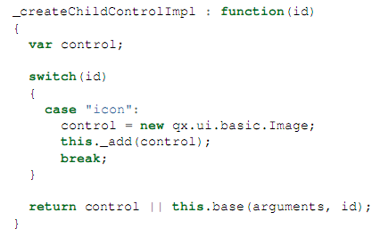
CUSTOM WIDGET
Child control
  Override method _createChildControlImpl
  Supported methods:
  getChildControl(id); _showChildControl(id); _excludeChildControl(id); _isChildControlVisible(id); hasChildControl(id);
Notes:
Qooxdoo support a mechanism call child control (a widget as part of another widget) to make easy to access and refine child controls when a class be extended. Each child control using an id which is a lower-case string.
This mechanism

Slide 5
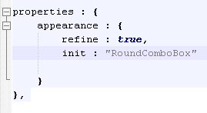
CUSTOM WIDGET
Appearance
  Appearance of widget: manually indicated in properties section of widget class
  Child control appearance: supported by appearance system : selector created automatically
    RoundComboBox/list
    RoundComboBox/popup
    RoundComboBox/button
    RoundComboBox/textfield
  IMPORTANT: all appearance selectors must be defined in appearance.js of current theme
Notes:
Qooxdoo support a mechanism call child control (a widget as part of another widget) to make easy to access and refine child controls when a class be extended. Each child control using an id which is a lower-case string.
This mechanism

Slide 6
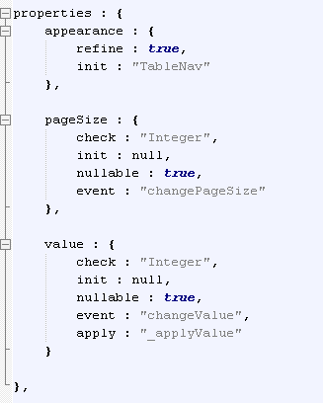
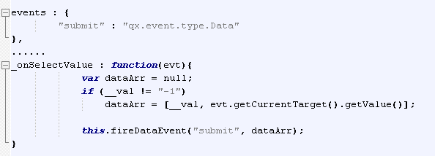
CUSTOM WIDGET
Events
  Class events
    Fire: fireDataEvent() called
    Defined in event section
  Properties event
    Fire: properties value change
    Defined in properties section
Notes:
Qooxdoo support a mechanism call child control (a widget as part of another widget) to make easy to access and refine child controls when a class be extended. Each child control using an id which is a lower-case string.
This mechanism

Slide 7
DEMO CUSTOM WIDGET

Slide 8
Table Object
The table can be used to display tabular data in a grid
The table is a very powerful widget
The rows which are actually being viewed are rendered
Table Model
+
Custom object
Table Object

Slide 9
Table Object
Table model:
The table model is to read the data from.
Some Qooxdoo’s table model classes :
- qx.ui.table.model.Simple
- qx.ui.table.model.Remote
- qx.ui.table.model.Filtered
=>Those classes are implemented from interface (qx.ui.table.ITableModel)

Slide 10
Table Object
II. Custom object:
A map provided to override the various supplemental classes allocated with table constructor. Each property must be a function which returns an object instance.
The default custom object indicated as below:

Slide 11
Table Object
var custom =
{
tablePaneScroller: function(obj) { return return new qx.ui.table.pane.Scroller(obj);
},
selectionModel : function(obj) { return new qx.ui.table.selection.Model(obj);
},
selectManager: function (obj) { return new qx.ui.table.selection.Manager(obj);
} ,
tablePane : function(obj) { return new vsqxd.base.ui.table.pane.Pane(obj); ;
},
tablePaneModel: function(obj) { return new qx.ui.table.pane.Model(obj);
} ,
tablePaneHeader: function(obj) { return new qx.ui.table.pane.Header(obj);
} ,
columnMenu: function() { return new qx.ui.table.columnmenu.Button();
} ,
tableColumnModel: function(obj) { return new qx.ui.table.columnmodel.Basic(obj);
}
};

Slide 12
Table Object
Create a instance of table
var table=new qx.ui.table.Table(model?, custom?);
* If no custom parameter,The table will use default custom

Slide 13
Table Object
2. Some of common properties:
How to frozen a metacomlumn:
=> using table.setMetaColumnCounts(array)
array parameter include the number of columns per meta column. If the last array entry is -1, this meta column will get the remaining columns
How to do datacellrenderer
=>using table.getTableColumnModel().setDataCellRenderer (indexCol, renderer);
renderer parameter is one of render methods supported by Qooxdoo such as:
+ qx.ui.table.cellrenderer.Html();
+ qx.ui.table.cellrenderer.Default();
+ and all class in qx.ui.table.cellrenderer namespace
c. Set row hover
=>using table.setFocusCellOnMouseMove(true);

Slide 14
Table Object
3. Example:
var tableModel = new qx.ui.table.model.Simple();
var header=[ "ID", "A number", "A date", "Boolean“, ”A Link” ];
tableModel.setColumns(header);
var rowData =
[
[ 1, 1234, “25/11/2010”, false, “<a href=‘# ‘> link1</a>”],
[ 2, 2345, “25/11/2010”, false, “<a href=‘# ‘> link2</a>”],
[ 3, 3456, “25/11/2010”, false, “<a href=‘# ‘> link3</a>”],
[ 4, 4567, “25/11/2010”, false, “<a href=‘# ‘> link4</a>”]
]
tableModel.setData(rowData);
tableModel.setColumnEditable(1, true);
tableModel.setColumnEditable(2, true);
tableModel.setColumnSortable(3, false);
tableModel.setColumnEditable(4, false);

Slide 15
Table Object
3. Example:
var table = new qx.ui.table.Table(tableModel);
table.set({ width: 600, height: 400, decorator: null });
table.setMetaColumnCounts([2,-1]); table.getSelectionModel().setSelectionMode(qx.ui.table.selection.Model.MULTIPLE_INTERVAL_SELECTION);
var tcm = table.getTableColumnModel();
// display a checkbox in column 3
tcm.setDataCellRenderer(3, new qx.ui.table.cellrenderer.Boolean());
// use a different header renderer
tcm.setHeaderCellRenderer(2, new qx.ui.table.headerrenderer.Icon("icon/16/apps/office-calendar.png", "A date"));

Slide 16
Table Object
//use renderer Html in column 4
tcm. setDataCellRenderer(4, new qx.ui.table.cellrenderer.Html());
Run Demo Now

Slide 17
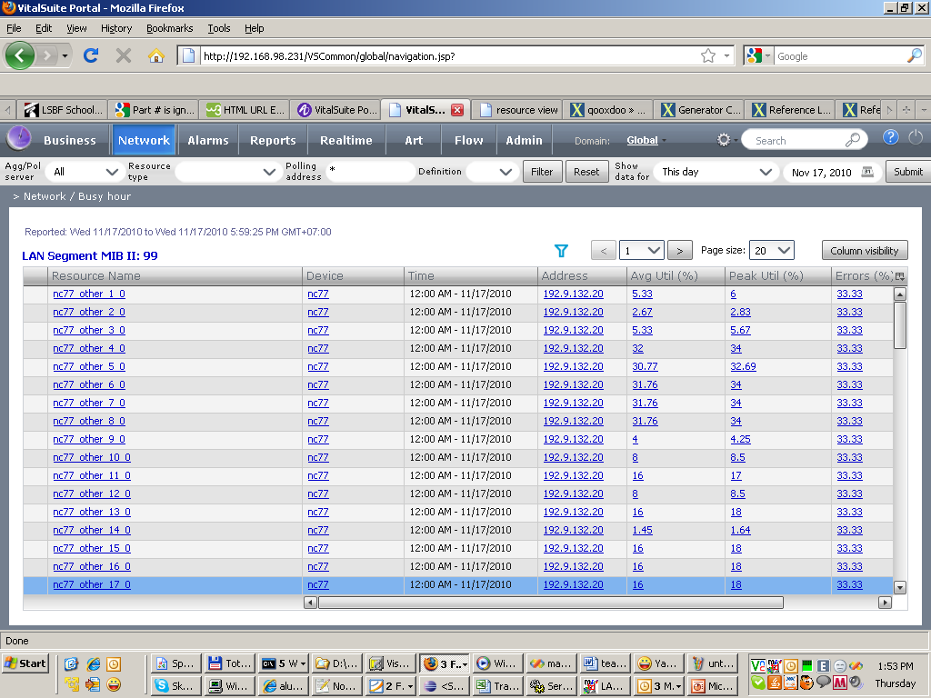
ALUTable Object

Slide 18
Tree Object
TreeFile
+
TreeFolder
Tree Object

Slide 19
Tree Object
1. Tree Nodes:
Body node:
var node=new qx.ui.tree.TreeFolder();
=>The tree folder is a tree element, which can have nested tree elements
Leaf node:
var node=new qx.ui.tree.TreeFile();
=>The tree file is a leaf tree item. It cannot contain any nested tree items.

Slide 20
Tree Object
2. Create a instance of tree
var tree=new qx.ui.tree.Tree();
3. Some of common methods:
getRoot(), setRoot(); =>use to get/set root node for tree instance.
addToSelection(item);=> add the item will be selected.
getSelection();=>use to get Widget Array of selected items
setHideRoot(Boolean);=> true: the root hidden. false the root visible.

Slide 21
Tree Object
4. Example:
Create Normal Tree:
var tree = new qx.ui.tree.Tree().set({ width : 200, height : 400 });
var root = new qx.ui.tree.TreeFolder("root"); root.setOpen(true);
tree.setRoot(root);
var te1 = new qx.ui.tree.TreeFolder("Desktop"); te1.setOpen(true)
root.add(te1);
var te1_1 = new qx.ui.tree.TreeFolder("Files");
var te1_2 = new qx.ui.tree.TreeFolder("Workspace");
var te1_3 = new qx.ui.tree.TreeFolder("Network");
te1.add(te1_1, te1_2, te1_3, te1_4);
var te1_2_1 = new qx.ui.tree.TreeFile("Windows (C:)");
var te1_2_2 = new qx.ui.tree.TreeFile("Documents (D:)"); te1_2.add(te1_2_1, te1_2_2);

Slide 22
Tree Object
4. Example:
b. Json To Tree: tree.json
{
"name": "root",
"kids": [
{ "name": "1",
"kids": [
{ "name": "1.1" },
{ "name": "1.2"},
{ "name": "1.3"}
]
}
]
}

Slide 23
Tree Object
Coding:
var tree = new qx.ui.tree.Tree();
tree.setWidth(200);
tree.setHeight(300);
// create the controller
var controller = new qx.data.controller.Tree(null, tree, "kids", "name");
// create the data store
var url = "json/tree.json";
var store = new qx.data.store.Json(url);
// connect the store and the controller
store.bind("model", controller, "model");
// show the data in the list when loaded
store.addListener("loaded", function(ev) { tree.getRoot().setOpen(true); }, this);

Slide 24
Tree Object
Run Demo Now

Slide 25
DEVELOPMENT TOOL
Spket IDE, notepad++
Firefox plugins: web developer, firebug, colorzilla, measureit

Slide 26
CONTENT
Qooxdoo development (cont)
  Custom widget
  Common widget in Qooxdoo
    Table
    Tree
  Tool
Qooxdoo and VitalSuite
  VitalSuite new and old navigation structure
  VS Qooxdoo application structure in our product and how to apply it to VS

Slide 27
NAVIGATION STRUCTURE
Old
New
navigation.jsp
<iframe name=‘content’/>
<iframe name=‘subcontent’/>
Vsqxd.js

Slide 28

VSQXD APPLICATION
Class folder structure
  base: common component definition classes
  pages: VS page implement classes
  theme: classes for theme definition
  Application.js : main application class, contain app main function, role as dispatcher

Slide 29
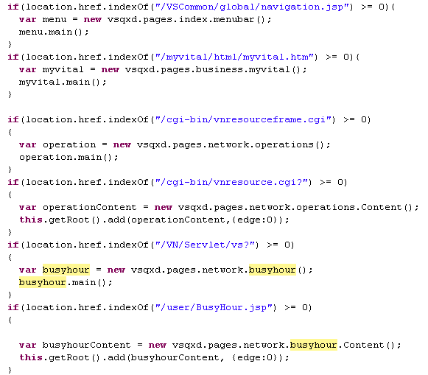
VSQXD APPLICATION
App’s main function : dispatcher
  Analysis current URL
  Create instance of appropriate class
  Call class’s main function

Slide 30
VSQXD APPLICATION
navigation.jsp
<iframe name=‘content’ = src=’vnresourceframe.cgi’/>
<iframe name=‘subcontent’/>
Vsqxd.js
main : function(){
if(location.href.indexOf("/VSCommon/global/navigation.jsp") >= 0){
var menu = new vsqxd.pages.index.menubar();
menu.main();}
if(location.href.indexOf("/cgi-bin/vnresourceframe.cgi") >= 0) {
var operation = new vsqxd.pages.network.operations();
operation.main();}
if(location.href.indexOf("/cgi-bin/vnresource.cgi?") >= 0){
var operationContent = new vsqxd.pages.network.operations.Content(); this.getRoot().add(operationContent,{edge:0}); }

Slide 31
QOOXDOOLIZE A PAGE
Identify second page URL
Change second page structure
  Inject vsqxd script
  Change page layout from “frame | frame” to “div / iframe(3rd page)”
Implement functionalities (second and third page).

